Slide 1
Customer Retention Analysis
By Henry Vo

Slide 2
Repeat Customers vs. One-Time Buyers
Repeat Customers
One-Time Buyers
Revenue
$8.4M
$600K
Number of Customers
2845
1494
Repeat Customers generate 93% of revenue, making retention a crucial driver of business growth

Slide 3
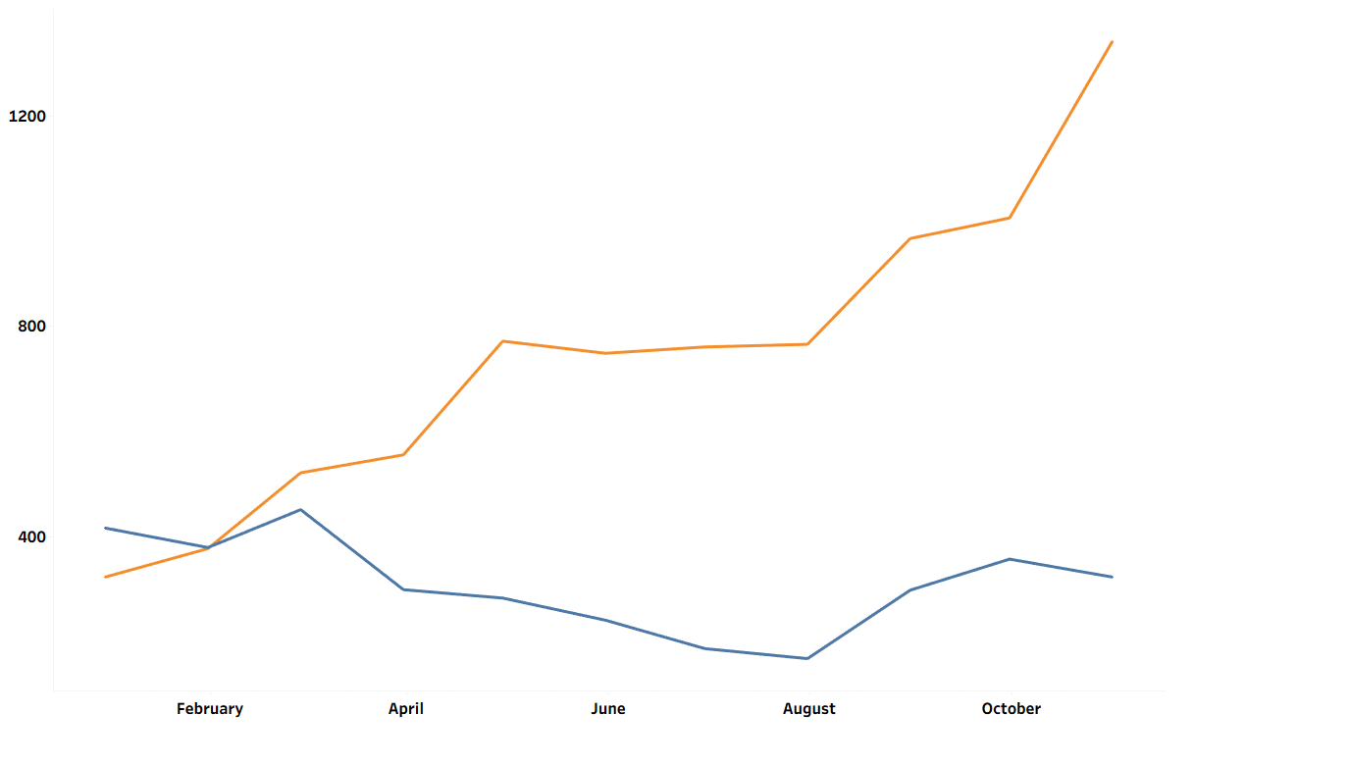

Growth driven by Returning Customers
Returning customers are becoming an increasingly more important revenue driver
To sustain the growth of returning customers, we must understand customer retention and churn behaviors

Slide 4
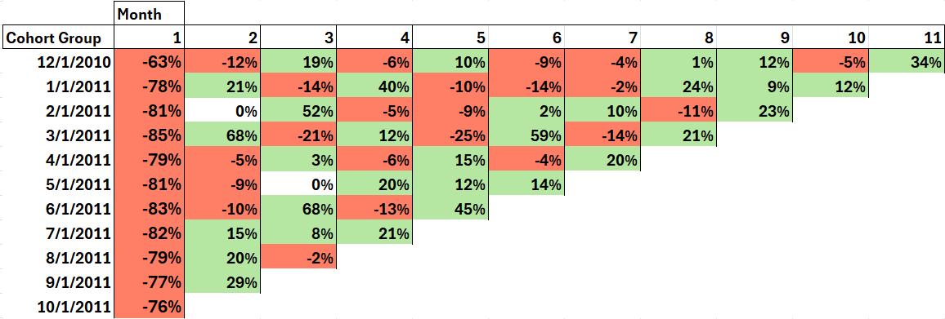
Most Customers churn within the first 3 months
Percentage change in Customer Per Month
79% of Customers churn after the first month
Retention generally improves in months 5-7
Retention varies widely by cohort, signifying inconsistent customer experience

Slide 5
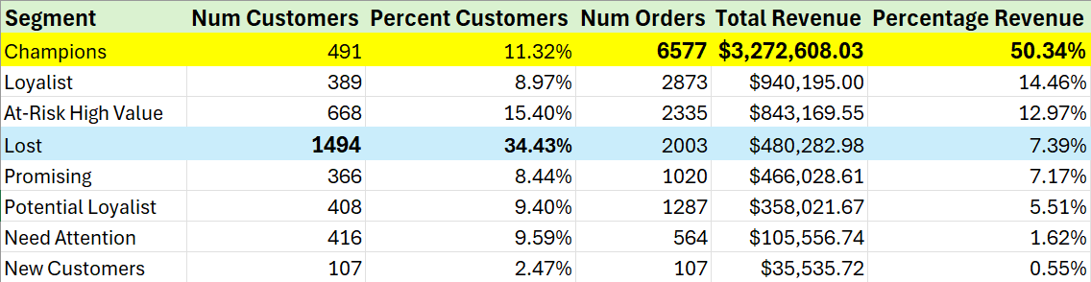
Most Revenue is driven by a small customer group
Nearly half of our customers are either “Lost” or “At-Risk High Value,” representing the largest opportunity for retention
These two groups make up over 20% of revenue, providing the biggest growth potential

Slide 6
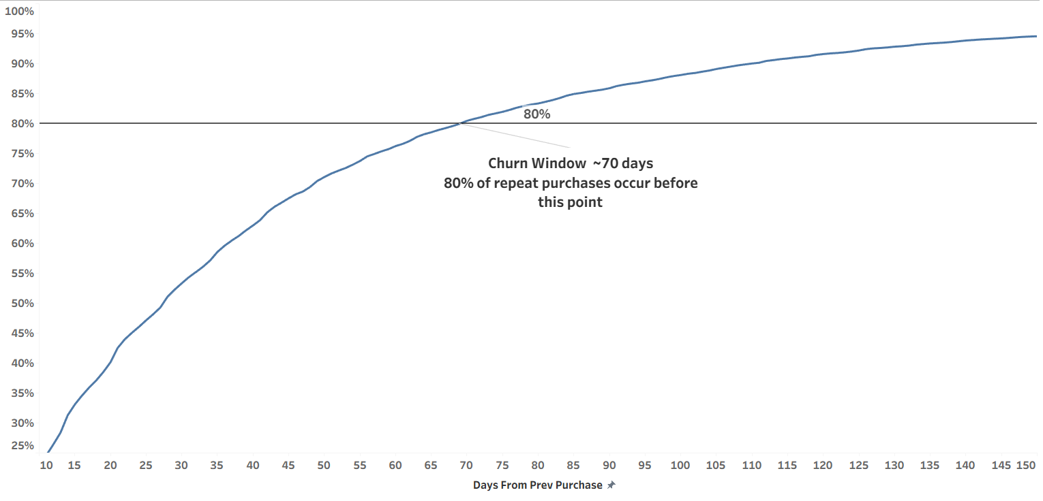
Customers are considered churned after ~70 days
Defining the churn window enables retention outreach by identifying when intervention is most optimal

Slide 7
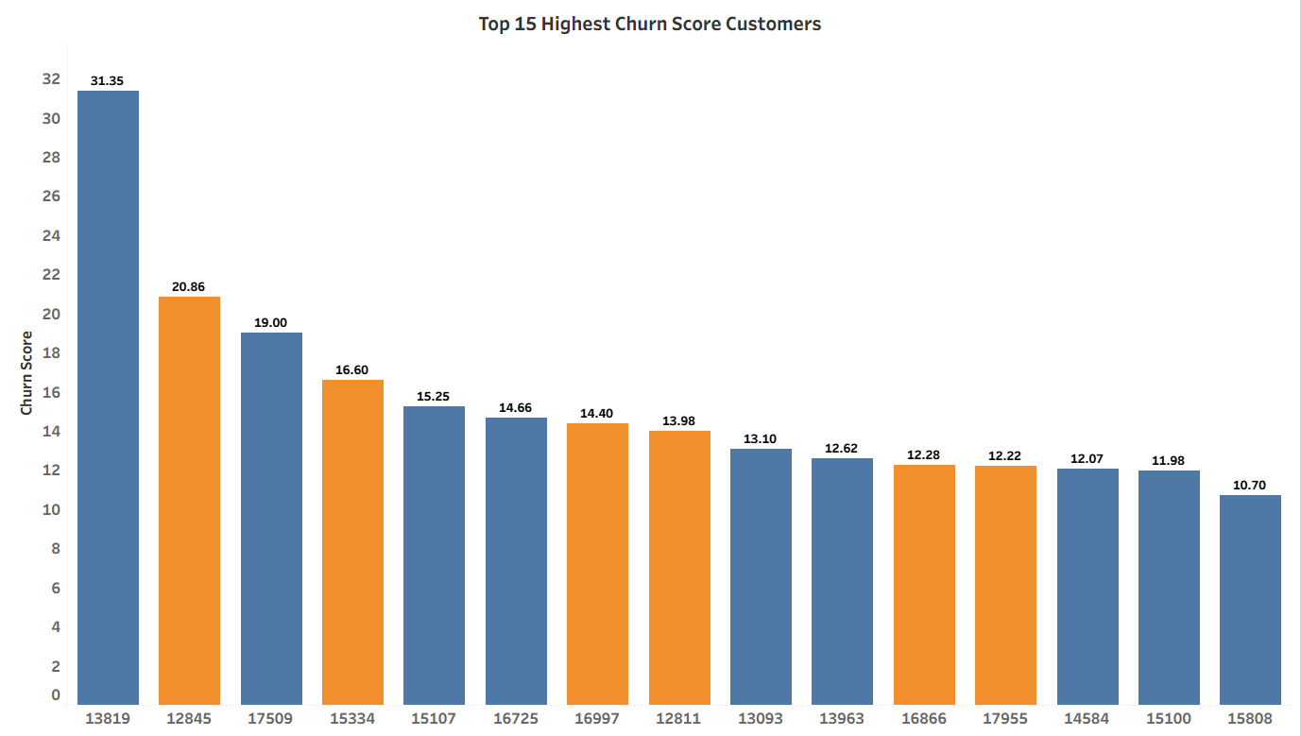

Top 15 Highest Churn Score Customers
These customers present a clear opportunity for focused retention outreach by representing the highest near-term churn risk
Highest risk customers are concentrated in “Lost” and “At-Risk High Value” customer segments
Customer ID

Slide 8
Recommendations
Segment
Recommended Action
Loyalty Rewards and early access to maintain strong customer loyalty
Champions
Re-engagement emails or product reminders
At-Risk High Value (Almost churned)
Win-back campaign to target customers with highest churn score
Lost (Fully Churned)

